Slide 1
Machine Learning Studio
[Speaker Name]

Slide 2
Azure Machine Learning Studio is a powerfully simple browser-based, visual drag-and-drop authoring environment where no coding is necessary. Go from idea to deployment in a matter of clicks.

Slide 3
What is machine learning?
Machine learning (ML) enables computers to learn from data and experiences and to act without being explicitly programmed.
Azure Machine Learning is a cloud predictive analytics service that makes it possible to quickly create and deploy predictive models as analytics solutions.
With ML Studio you can build Artificial Intelligence (AI) applications that intelligently sense, process, and act on information - augmenting human capabilities, increasing speed and efficiency, and helping organizations achieve more.

Slide 4
Microsoft Azure Machine Learning Studio
A fully-managed cloud service that enables you to easily build, deploy, and share predictive analytics solutions.
Collaborative, drag-and-drop tool you can use to build, test, and deploy predictive analytics solutions on your data.
ML Studio publishes models as web services that can easily be consumed by custom apps or BI tools such as Excel.

Slide 5
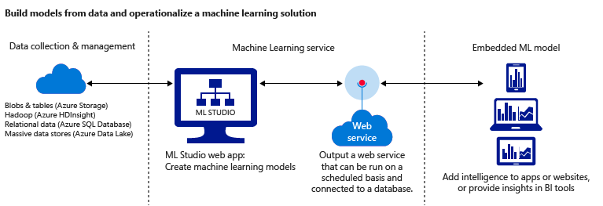
Microsoft Azure Machine Learning Studio

Slide 6
Five steps to create an experiment
Before you start:
Open Machine Learning Studio: https://studio.azureml.net and Sign In.
If you’ve signed into Machine Learning Studio before, click Sign In.
Otherwise, click Sign up here and choose between free and paid options.
Create a model
Step 1: Get data
Step 2: Prepare the data
Step 3: Define features
Train the model
Step 4: Choose and apply a learning algorithm
Score and test the model
Step 5: Predict new automobile prices

Slide 7
Demo

